Slide 1


Linear Model Classification: Logistic Regression
Welcome to this comprehensive presentation on Logistic Regression, a fundamental supervised machine learning algorithm used for classification tasks. We'll explore what makes logistic regression powerful for predicting categorical outcomes through probability estimation.

Slide 2
What is Logistic Regression?
Definition
Core Function
Classification Output
Logistic regression is a supervised machine learning algorithm used for classification tasks where the goal is to predict the probability that an instance belongs to a given class.
It analyzes the relationship between data factors, using a sigmoid function that takes input variables and produces probability values between 0 and 1.
If the function value for an input is greater than 0.5 (threshold value), it belongs to Class 1; otherwise, it belongs to Class 0.

Slide 3
Key Points of Logistic Regression
1
Categorical Output
2
Probabilistic Values
3
S-Shaped Function
Logistic regression predicts the output of a categorical dependent variable. The outcome must be a categorical or discrete value, such as Yes/No, 0/1, or True/False.
Instead of giving exact values like 0 and 1, logistic regression provides probabilistic values that lie between 0 and 1, indicating the likelihood of belonging to a class.
Rather than fitting a regression line, logistic regression fits an "S" shaped logistic function that predicts two maximum values (0 or 1).

Slide 4
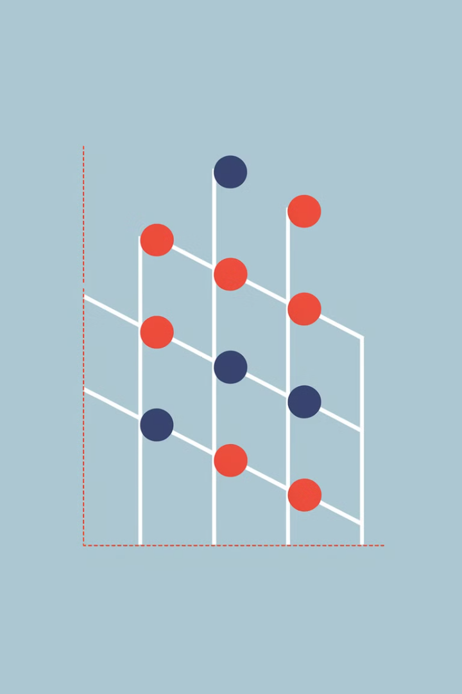
Binary Classification with Logistic Regression
Decision Process
Threshold Application
In binary classification, logistic regression converts a continuous input into a probability value between 0 and 1 using the sigmoid function.
A threshold value (typically 0.5) determines class assignment: values above the threshold are classified as Class 1, while values below are classified as Class 0.
Extension of Linear Regression
Logistic regression is an extension of linear regression but specially adapted for classification problems rather than continuous value prediction.

Slide 5
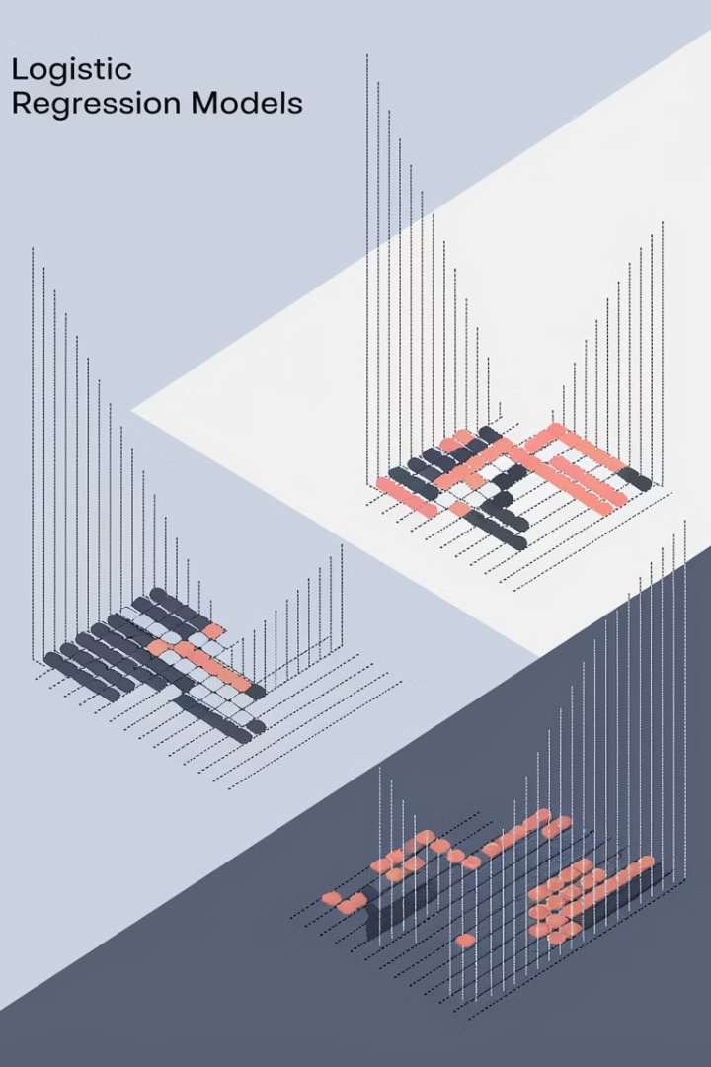



Types of Logistic Regression
Binomial
Multinomial
Ordinal
Has only two possible outcomes for the dependent variable, such as 0 or 1, Pass or Fail. Uses sigmoid function to produce probability values.
Can have 3 or more possible unordered types of the dependent variable, such as "cat", "dogs", or "sheep". Uses softmax function instead of sigmoid.
Handles 3 or more possible ordered types of dependent variables, such as "low", "Medium", or "High", preserving the natural ordering of categories.

Slide 6



Binomial Logistic Regression
Binary Classification
Sigmoid Function
Common Applications
Binomial logistic regression is used when the dependent variable has exactly two possible outcomes. These outcomes are mutually exclusive, such as Yes/No, Pass/Fail, or Alive/Dead.
It employs the sigmoid function to transform linear combinations of inputs into probabilities between 0 and 1. The threshold (typically 0.5) determines the final classification.
Frequently used in medical diagnosis, spam detection, credit approval, and other scenarios where the outcome is binary in nature.

Slide 7

Multinomial Logistic Regression
1
Multiple Classes
Multinomial logistic regression extends binary classification to handle three or more unordered categorical outcomes, such as predicting fruit types (apple, orange, banana) or disease classifications.
2
Softmax Function
Instead of the sigmoid function, it uses the softmax function to convert input values into class probabilities that sum to 1 across all possible classes.
3
Mathematical Representation
For class c, the probability is calculated as:
P(Y=c|X=x) = (e^(w_c·x+b_c))/(∑(k=1 to K)e^(w_k·x+b_k))
4
Application Example
Used in handwritten digit recognition where the model must classify digits (0-9) based on pixel data, as demonstrated in the digits dataset example.

Slide 8
Ordinal Logistic Regression
Ordered Categories
1
Ordinal logistic regression handles dependent variables with three or more categories that have a natural order or ranking, such as education levels (elementary, high school, bachelor's, master's) or satisfaction ratings (low, medium, high).
Preserves Order
2
Unlike multinomial regression, it accounts for the ordered relationship between categories, ensuring predictions respect the inherent hierarchy of the dependent variable.
Cumulative Approach
3
Often implemented using cumulative logits, where the probability of being in a category or higher is modeled, preserving the ordinal nature of the data.

Slide 9
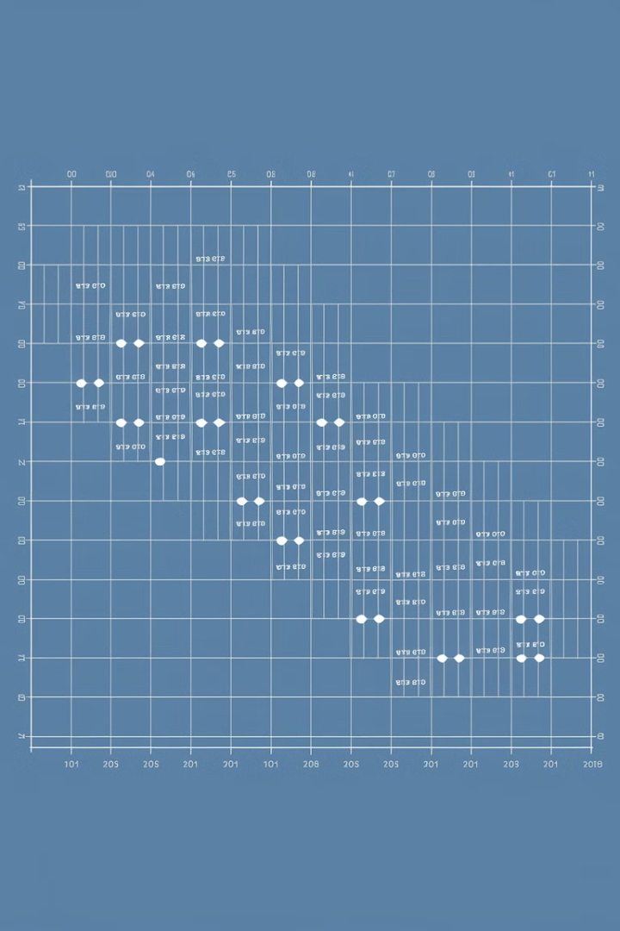



Assumptions of Logistic Regression (Part 1)
Independent Observations
Each observation must be independent of others. There should be no correlation between any input variables, meaning one observation should not influence another.
Binary Dependent Variables
For binary logistic regression, the dependent variable must be binary or dichotomous, meaning it can take only two values. For more than two categories, softmax functions are used.
Linearity Relationship
The relationship between the independent variables and the log odds of the dependent variable should be linear. This means a linear combination of predictors relates to the log odds.

Slide 10




Assumptions of Logistic Regression (Part 2)
No Outliers
Large Sample Size
The dataset should not contain significant outliers that could disproportionately influence the model.
1
The sample size should be sufficiently large to ensure robust estimation.
2
Complete Separation
4
No Multicollinearity
Avoid situations where the outcome can be perfectly predicted by a variable.
3
Predictor variables should not be highly correlated with each other.

Slide 11
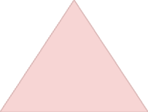



Understanding the Sigmoid Function
Probability Mapping
1
Maps any real value to a probability between 0 and 1
S-Shaped Curve
2
Forms a characteristic "S" curve shape
Threshold Application
3
Values above threshold tend to 1, below tend to 0
Mathematical Core
4
Core function of logistic regression
The sigmoid function is a mathematical function that maps any real-valued number to a value between 0 and 1. This is perfect for converting the output of a linear function into a probability value, which is essential for classification tasks. The function creates an S-shaped curve that smoothly transitions between the extremes.

Slide 12

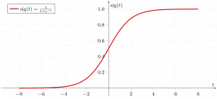
Sigmoid Function Visualization
0
0.5
Lower Limit
Midpoint
As input approaches negative infinity, output approaches zero
When input is zero, output is exactly 0.5
1
Upper Limit
As input approaches positive infinity, output approaches one
The mathematical formula for the sigmoid function is:
σ(z) = 1/(1+e^(-z))
This function takes any real-valued number and transforms it into a value between 0 and 1. At the point where z=0, the function outputs exactly 0.5, which is often used as the classification threshold in binary logistic regression.

Slide 13
How Logistic Regression Works
Classification Decision
Probability Interpretation
Sigmoid Transformation
Finally, a threshold (typically 0.5) is applied to convert the probability into a binary class prediction
Linear Transformation
The resulting probability value represents the likelihood of the positive class: P(y=1) = σ(z) and P(y=0) = 1-σ(z)
The linear output is then passed through the sigmoid function to transform it into a probability value between 0 and 1: σ(z) = 1/(1+e^(-z))
First, a linear combination of input features is calculated using weights and bias, similar to linear regression: z = w·X + b

Slide 14
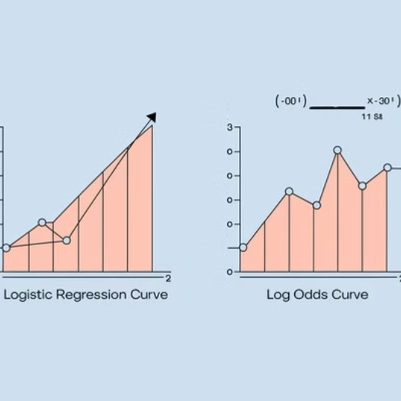
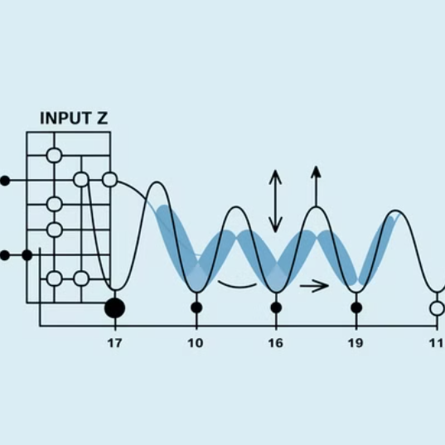

Equation of Logistic Regression
The odds ratio in logistic regression represents the ratio of something occurring to something not occurring. It differs from probability, which is the ratio of something occurring to everything that could possibly occur.
The odds can be expressed as: p(x)/(1-p(x)) = e^z
Taking the natural logarithm of the odds (log odds) gives us: log[p(x)/(1-p(x))] = w·X + b
The final logistic regression equation becomes: p(X;b,w) = e^(w·X + b)/(1+e^(w·X + b)) = 1/(1+e^(-(w·X + b)))

Slide 15
Likelihood Function for Logistic Regression
For y=1
Predicted probability = p(X;b,w) = p(x)
For y=0
Predicted probability = 1-p(X;b,w) = 1-p(x)
Likelihood function
L(b,w) = ∏(i=1 to n) p(x_i)^y_i(1-p(x_i))^(1-y_i)
Log-likelihood
log(L(b,w)) = ∑(i=1 to n) y_i log p(x_i) + (1-y_i)log(1-p(x_i))
The likelihood function represents the probability of observing the given data points with their corresponding labels, given the model parameters. By maximizing this function (or equivalently, its logarithm), we find the optimal parameters for our logistic regression model.
The log-likelihood function simplifies the computation and is used in the optimization process to find the best weights and bias for the model.

Slide 16
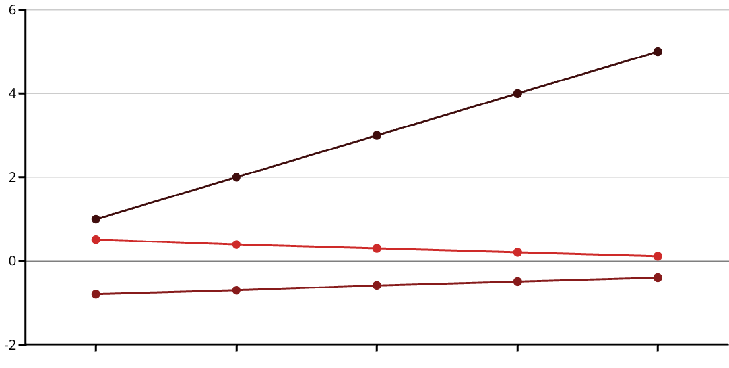
Gradient of the Log-Likelihood Function
Iteration
Log-Likelihood
Gradient Magnitude
To find the maximum likelihood estimates, we differentiate the log-likelihood function with respect to the weights. The gradient of the log-likelihood function is given by:
∂J(l(b,w))/∂w_j = ∑(i=n to n)(y_i - p(x_i;b,w))x_ij
This gradient expression has an intuitive interpretation: it's the sum of the differences between the actual labels (y_i) and the predicted probabilities, weighted by the feature values. When the predictions match the actual labels perfectly, the gradient becomes zero, indicating we've reached an optimum.

Slide 17
Key Terminologies in Logistic Regression
1
Independent and Dependent Variables
2
Logistic Function and Odds
The independent variables are the input characteristics or predictors, while the dependent variable is the target we're trying to predict, typically binary in nature for binary logistic regression.
The logistic function transforms inputs into probabilities. Odds represent the ratio of something occurring to not occurring, different from probability which is the ratio of occurrence to all possibilities.
3
Log-Odds and Coefficients
4
Maximum Likelihood Estimation
Log-odds (logit function) is the natural logarithm of the odds. Coefficients in the model show how the independent and dependent variables relate to each other.
A method used to estimate the coefficients of the model by maximizing the likelihood of observing the given data points with their corresponding labels.

Slide 18
Code Implementation: Binary Logistic Regression
from sklearn.datasets import load_breast_cancer
from sklearn.linear_model import LogisticRegression
from sklearn.model_selection import train_test_split
from sklearn.metrics import accuracy_score
# load the dataset
X, y = load_breast_cancer(return_X_y=True)
X_train, X_test, y_train, y_test = train_test_split(X, y, test_size=0.20, random_state=23)
# create and train the model
clf = LogisticRegression(max_iter=10000, random_state=0)
clf.fit(X_train, y_train)
# evaluate the model
acc = accuracy_score(y_test, clf.predict(X_test)) * 100
print(f"Logistic Regression model accuracy: {acc:.2f}%")
This Python code demonstrates the implementation of binary logistic regression using the breast cancer dataset. The scikit-learn library provides a user-friendly interface for creating, training, and evaluating the model.
The dataset is first split into training and testing sets. Then, a LogisticRegression model is created and trained on the training data. Finally, the model's accuracy is evaluated on the test data, resulting in an impressive 96.49% accuracy.

Slide 19
Code Implementation: Multinomial Logistic Regression
from sklearn.model_selection import train_test_split
from sklearn import datasets, linear_model, metrics
# load the digits dataset
digits = datasets.load_digits()
X = digits.data
y = digits.target
# split data into training and testing sets
X_train, X_test, y_train, y_test = train_test_split(X, y, test_size=0.4, random_state=1)
# create and train the model
reg = linear_model.LogisticRegression(max_iter=10000, random_state=0)
reg.fit(X_train, y_train)
# evaluate the model
y_pred = reg.predict(X_test)
print(f"Logistic Regression model accuracy: {metrics.accuracy_score(y_test, y_pred) * 100:.2f}%")
This code implements multinomial logistic regression using the digits dataset, which contains images of handwritten digits (0-9). Despite having 10 different classes, the implementation is similar to binary logistic regression thanks to scikit-learn's abstraction.
The model achieves an impressive 96.66% accuracy on the test data, demonstrating the effectiveness of logistic regression for multi-class classification tasks when the underlying relationship between features and classes is approximately linear.

Slide 20




Summary: Logistic Regression in Machine Learning
Foundation
Logistic regression is a powerful supervised machine learning algorithm for classification tasks, using the sigmoid function to transform linear combinations of inputs into probabilities.
Versatility
It can handle binary, multinomial, and ordinal classification problems, making it a versatile tool for various applications from medical diagnosis to image recognition.
Implementation
Modern libraries like scikit-learn make it easy to implement logistic regression models with high accuracy, as demonstrated by the 96%+ accuracy achieved in both binary and multinomial examples.
Future Applications
Despite newer algorithms, logistic regression remains relevant for its interpretability, efficiency, and strong performance when assumptions are met.

